Slide 1
Contemplation, Dialogue, and Discernment

Slide 2
Why contemplation? Contemplation…taking a long loving look at the real
Centers all that we are, and all we desire to be on the movement of God’s spirit
Supports a “flexible shaping” and integration of prayer, reflection, dialogue in addressing any variety of topics, concerns, questions
Enables any conversation to become a spiritual experience rather than being about mere “business” or problem-solving

Slide 3
Engages our minds and hearts in movement toward a new consciousness – a new way of seeing, a new way of being
Assists a group in moving from “I” to “We”
Invites silence which supports slowing down, reflection, and deeper conversation
Allows for creative possibilities, emerging options, and peaceful resolution

Slide 4
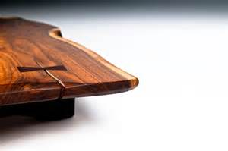
Contemplatio - templum
A piece of ground consecrated for worship
A place reserved or cut out
A cleared space in front of the altar
LIVE OUT of a “cleared space” in which God’s spirit dwells.

Slide 5
Movements in the Contemplative Process
Noticing what is …
OBSERVE
Without judgment
Pay attention
Take time and not rush to conclusions
Slow down and wait

Slide 6
Coming to Quiet
REFLECT
Externally:
A still body
External Silence
Internally:
Stilling the mind
Letting go of thoughts and chatter
Quieting the heart
Letting go/letting come
Listening…
to myself,
to/with others,
to the situation,

Slide 7
Act
Offer what I/we see and hear freely
Come to a decision and/or course of action
Returning to quiet receptivity
“Take a long, loving look at what is.”

Slide 8
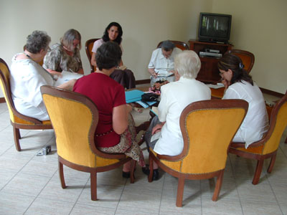
Contemplative Dialogue
Together we:
build on insights
encourage curiosity
make connections
seek patterns

Slide 9
Three Movements:
Observe, observe, observe
- What are you noticing in yourself, in others, in what is happening around you?
Reflect
- What meaning/understanding/conclusions do you draw from what you are observing?
Act
- What response will be made in light of observation and reflection?

Slide 10
Inner Dispositions
Open Mind
(commitment to truth)
- see with fresh eyes
Open Heart
(commitment to love)
- walk in the shoes of another
Open Will
(commitment to courage)
- let go of fear, new will come

Slide 11
Three Voices
Voice of Judgment
- stifles creativity
Voice of Cynicism
- only my way of thinking, doing
Voice of Fear
- cannot let go so new can come

Slide 12
Levels of Listening
Downloading: confirms what you already know
Factual Listening: you notice something new
Empathic listening: changes your perspective when you see through the eyes of another
Generative listening: you are changed as a person

Slide 13
Levels of Conversation
Downloading: talking nice, “same old”
Debate: talking tough, “my way” or no way
Dialogue: reflective inquiry, seeing myself as part of the whole
Deep Conversation: collective creativity, shifting from “I” to “we”

Slide 14
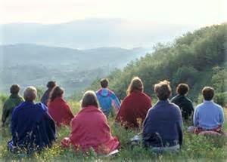
We need to evolve communally at the level of consciousness. It is an invitation to learn to transform the way we are together to evolve in our way of thinking, feeling, and loving when we are in relationship communally.
Lis Sweeney, SSJ

Slide 15
Contemplative Living
Contemplation is the fundamental reality of life. It makes life real and alive. It makes us truly human.
Contemplation goes beyond concepts and apprehends God not as a separate object but as the Reality within our reality, the Being within our being, the life of our life.
Thomas Merton

Slide 17
Sources include:
Adaptions and quotations from the work of
Catherine Bertrand, SSND
Marie McCarthy, SP
Mary Jo Nelson, OLVM
Carole Shinnick, SSND
Liz Sweeney, SSJ
Otto Scharmer & Peter Senge
Presented by Catherine Bertrand, SSND and Mary Jo Nelson, OLVM (LCWR 2015 National Assembly)

